Slide 1

D

Slide 2
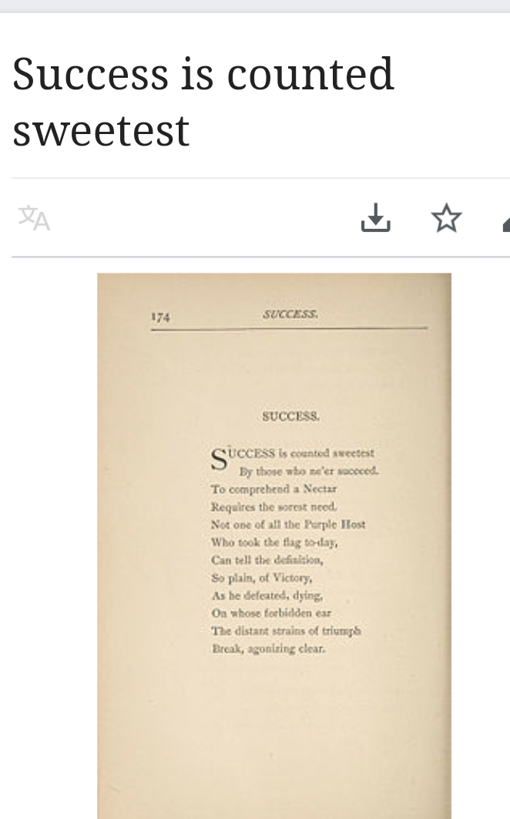

Slide 3
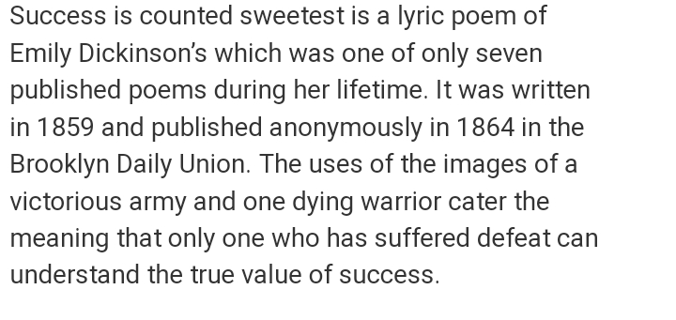

Slide 4


Slide 5
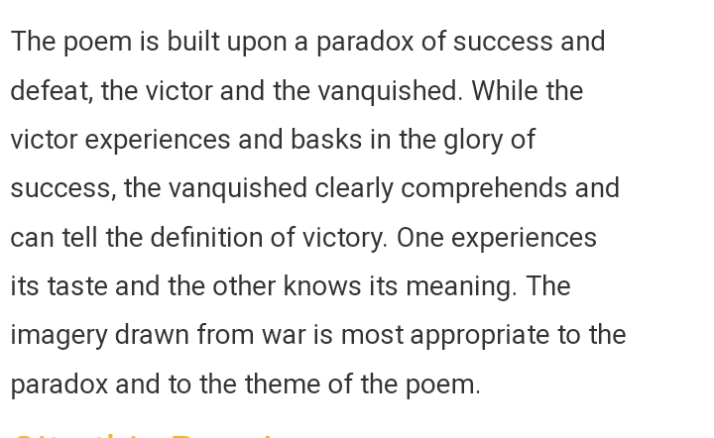
C

Slide 6
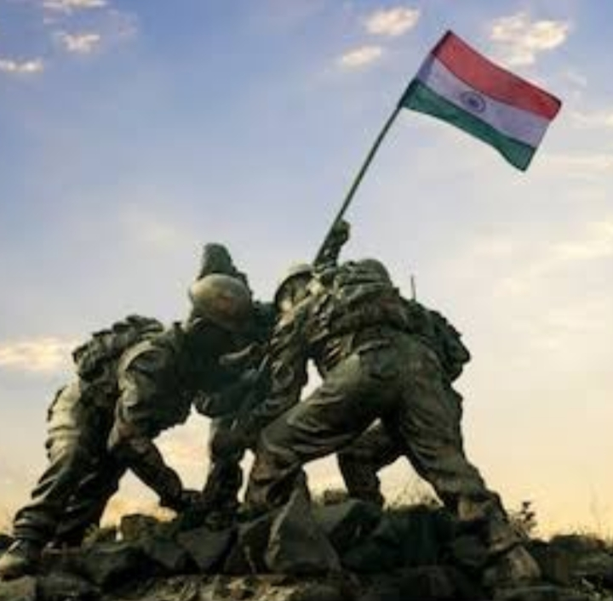

Slide 7
PRESENTED
By
DR ANUPAM BANSAL

